Slide 1
HSBC Google Cloud Hackathon
The Cloud Rockers

Slide 2

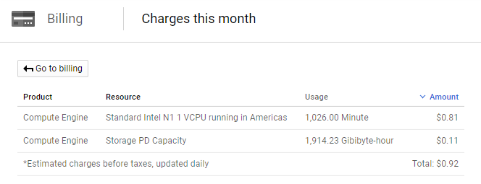
Orthodox Way
Cloud IAAS
GCP’s Compute Engine
Jenkins
SVN or Git
Is there another way as Compute engine seems costlier??
Actual Screenshot of project

Slide 3
Proposed Solution…
Cloud PAAS
GCP’s App Engine
BitBucket – As a Repository and Hot Deployment tool
MicroServices
Cloud Storage- Bucket
BitBucket
Hot Deployment to AppEngine using BitBucket Pipeline
http://hack-gcph-12.appspot.com
Client
Browser
AppEngine
Google
Cloud
Storage
Bucket

Slide 4
Continued…
We have used Bitbucket for hosting repositories, and implemented a deployment process to Google Cloud App Engine.
Google cloud has limitation like
a) We can use Jenkins only with Compute engine
b) We can use bit Bucket only with App Engine
App Engine manages your virtual machines, ensuring that:
a) Instances are health-checked, healed as necessary, and co-located with other services within the project.
b) Critical, backwards compatible updates are automatically applied to the underlying operating system.
c) VM instances are automatically located by geographical region according to the settings in your project.
Google's management services ensures that all of a project's VM instances are co-located for optimal
performance.
d) VM instances are restarted on a weekly basis. During restarts Google's management services will apply any necessary operating
system and security updates.
e) You always have root access to Compute Engine VM instances. SSH access to VM instances in the flexible environment is disabled
by default. If you choose, you can enable root access to your app's VM instances.

Slide 5

Scope of Improvement
Implementing Caching
Minimizing cost of project
Different types of Storage like Oracle, BigData etc.
Can be deployed to container engine for cluster deployment and management.
Deployment time can be reduced.

Slide 6
Thank you.

